Slide 1
Supplementary Fig. S1. Parameterization data sets used for modelling
Legend on next page

Slide 2
Supplementary Fig. S1. Parameterization data sets used for modelling
MK2206 time course in the presence of everolimus. BON1 cells were treated with everolimus (mTORC1 inhibitor) for 3 days in the presence or absence of MK2206 (Akt inhibitor) for the indicated time points. Subsequently, cells were serum starved for one hour and stimulated with TGFβ for 45 minutes. The mTOR and MAPK pathways were monitored by immunoblot. Data represent 4 biological replicates
Quantification of data shown in (A). Data represent the mean ± SEM. Data represent 4 biological replicates.
AZD6244 time course in the presence of everolimus. BON1 cells were treated with everolimus (mTORC1 inhibitor) for 3 days in the presence or absence of AZD6244 (MEK inhibitor) for the indicated time points. Subsequently, cells were serum starved for one hour and stimulated with TGFβ for 45 minutes. The mTOR and MAPK pathways were monitored by immunoblot. Data represent 4 biological replicates.
Quantification of data shown in (C). Data represent the mean ± SEM. Data represent 4 biological replicates.

Slide 3
Supplementary Fig. S2. General model topology of the MAPK, mTOR and TGFβ pathway
General structure of the ordinary differential model (ODE) model generated

Slide 4
Supplementary Fig. S3. Model simulations with models 1.1, 1.2 and 1.3
Legend on next page

Slide 5
Supplementary Fig. S3. Model simulations with models 1.1, 1.2 and 1.3
Model simulation using model 1.1. Dots represent the experimental data (Supplementary Fig. S1), shown as mean ± SEM. Lines are the simulations. The corresponding AIC value is indicated at the top.
Model simulation using model 1.2. Dots represent the experimental data (Supplementary Fig. S1), shown as mean ± SEM. Lines are the simulations. The corresponding AIC value is indicated at the top.
Model simulation using model 1.3. Dots represent the experimental data (Supplementary Fig. S1), shown as mean ± SEM. Lines are the simulations. The corresponding AIC value is indicated at the top.

Slide 6
Supplementary Fig. S4. Model simulations with models 2.1, 2.2 and 2.3
Legend on next page

Slide 7
Supplementary Fig. S4. Model simulations with models 2.1, 2.2 and 2.3
Model simulation using model 2.1. Dots represent the experimental data (Supplementary Fig. S1), shown as mean ± SEM. Lines are the simulations. The corresponding AIC value is indicated at the top.
Model simulation using model 2.2. Dots represent the experimental data (Supplementary Fig. S1), shown as mean ± SEM. Lines are the simulations. The corresponding AIC value is indicated at the top.
Model simulation using model 2.3. Dots represent the experimental data (Supplementary Fig. S1), shown as mean ± SEM. Lines are the simulations. The corresponding AIC value is indicated at the top.

Slide 8
Supplementary Fig. S5. Model prediction using models 2.2 and 2.3
Prediction on the effect of Akt and MEK inhibition on Smad2-pS465/467. Dots represent the experimental data (Fig. 2D), shown as mean ± SEM. The line is the prediction performed by model 2.2 (left) or model 2.3 (right)

Slide 9
Supplementary Fig. S6. Model simulations with models 2.1, 2.2 and 2.3
Legend on next page

Slide 10
Supplementary Fig. S6. Model simulations with models 2.1, 2.2 and 2.3
Model simulation using model 2.1. Dots represent the experimental data (Supplementary Fig. S1 and Fig. 2D), shown as mean ± SEM. Lines are the simulations. The corresponding AIC value is indicated at the top.
Model simulation using model 2.2. Dots represent the experimental data (Supplementary Fig. S1 and Fig. 2D), shown as mean ± SEM. Lines are the simulations. The corresponding AIC value is indicated at the top.
Model simulation using model 2.3. Dots represent the experimental data (Supplementary Fig. S1 and Fig. 2D), shown as mean ± SEM. Lines are the simulations. The corresponding AIC value is indicated at the top.

Slide 11
Supplementary Fig. S7. Everolimus-dependent SMAD2 phosphorylation is TSC1 and TSC2 independent
Legend on next page

Slide 12
Supplementary Fig. S7. Everolimus-dependent SMAD2 phosphorylation is TSC1 and TSC2 independent
TSC2 knockout BON1 cells show impaired mTORC1 inhibition. Control and TSC2 knock out (TSC2 K.O.) BON1 cells were amino acid and serum starved with HBSS for the indicated time points. TSC2 and S6K-pT389 were monitored by immunoblot. Data represent 3 biological replicates.
Quantification of data shown in (A). S6K-pT389 levels were compared between the different conditions using a two-way ANOVA followed by a Bonferroni multiple comparison test across 3 biological replicates. Data represent the mean ± SEM. The p-values for the Bonferroni multiple comparison tests are shown. ns, not-significant; **, p ≤ 0.01.
Everolimus-enhanced Smad2 phosphorylation is TSC1-independent. Control and TSC1 knock out (TSC1 K.O.) cells were treated with everolimus (mTORC1 inhibitor) for 3 days in the presence or absence of MK2206 (Akt inhibitor). Subsequently, cells were serum starved for one hour and stimulated with TGFβ for 45 minutes. TSC1, Smad2-pS465/467, Akt-pT308, S6K-pT389, ERK-pT202/Y204 and PRAS40-pT246 were monitored by immunoblot. Data represent XX biological replicates.
Quantification of data shown in (c). Smad2-pS465/467 levels were compared between the different conditions using a two-way ANOVA followed by a Bonferroni multiple comparison test across 3 biological replicates. Data represent the mean ± SEM. The p-values for the Bonferroni multiple comparison tests are shown. ns, not-significant.
TSC1 knockout BON1 cells show impaired mTORC1 inhibition. Control and TSC1 knock out (TSC1 K.O.) cells were amino acid and serum starved. TSC1 and S6K-pT389 were monitored by immunoblot. Data represent 3 biological replicates.
Quantification of data shown in (e). S6K-pT389 levels were compared between the different conditions using a two-way ANOVA followed by a Bonferroni multiple comparison test across 3 biological replicates. Data represent the mean ± SEM. The p-values for the Bonferroni multiple comparison tests are shown. ns, not-significant; **, p ≤ 0.01.
TGFb receptor and TGFb levels

Slide 13
Supplementary Fig. S8. Characterization of everolimus-dependent TGFβ transcription regulation
Legend on next page

Slide 14
Supplementary Fig. S8. Characterization of everolimus-dependent TGFβ transcription regulation
Growth analysis of BON1 cells upon everolimus and SMAD2/3 knockdown. BON1 cells were cultured in the presence of everolimus (mTORC1 inhibitor) and/or Smad2 knockdown (siSMAD2) and/or Smad2 knockdown (siSmad3). . The cell covered area in the bright field images was measured over 100 hours by live cell imaging. Data are shown as the mean ± SEM of 3 biological replicates.
Statistical analysis of data shown in (A). Area under the curves (AUC) were calculated for each biological replicate. The AUC was compared between the different conditions using a two-tailed student’s t-test across 3 biological replicates. Data represent the mean ± SEM. ns, not-significant; *,p≤0.05; **, p ≤ 0.01.
Representative images of cells measured in (a) after 70 hours.
Everolimus-enhanced Smad2 phosphorylation is TGFβR dependent. BON1 cells were treated with everolimus (mTORC1 inhibitor) for 3 days in the presence or absence of LY2157299 (TGFβR inhibitor). Subsequently, cells were serum starved for one hour and stimulated with TGFβ for 45 minutes. Smad2-pS465/467, Smad3-pS426/425, S6K-pT389, Akt-pT308 and ERK-pT202/Y204 were monitored by immunoblot. Data represent 8 biological replicates.
Quantification of data shown in (D). Smad2-pS465/467 and Smad3-pS423/425 levels were compared between the different conditions using a one-way ANOVA followed by a Bonferroni multiple comparison test across 8 biological replicates. Data represent the mean ± SEM. The p-values for the Bonferroni multiple comparison tests are shown. ***, p ≤ 0.001.
Analysis of TGFβ-dependent gene expression upon everolimus treatment. BON1 cells were treated with everolimus and/or LY2157299 for 3 days. Subsequently, RNA was extracted and a qPCR analysis was performed. Data are shown as the mean ± SEM of 4 biological replicates.
Growth analysis of BON1 cells upon mTORC1 and XXX. BON1 NucLight cells were cultured in the presence of everolimus (mTORC1 inhibitor), XXXX. XXX and S6K-pT389 were monitored by immunoblot. Data represent 3 biological replicates.

Slide 15
Supplementary Fig. S9. Mice experiment data

Slide 16
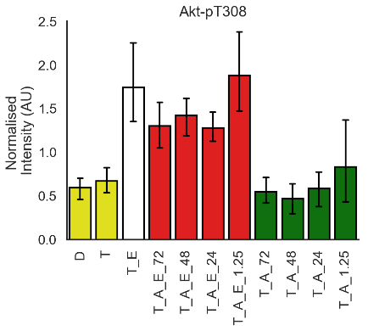
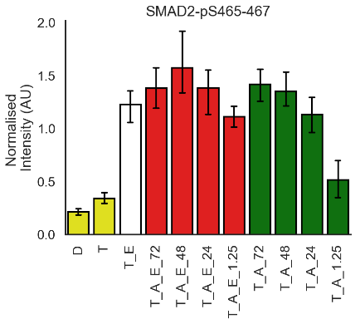
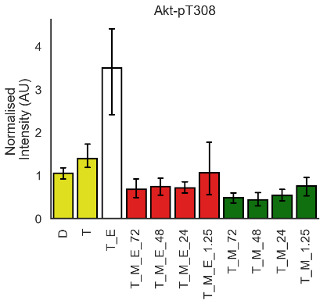
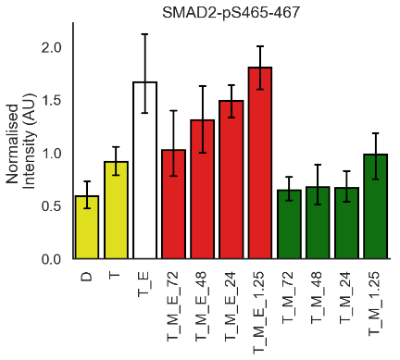
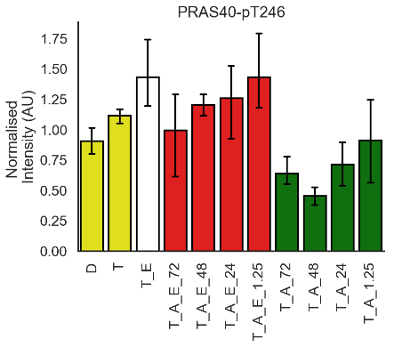
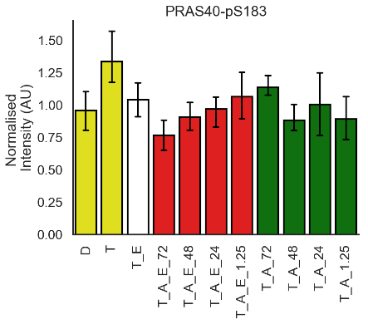
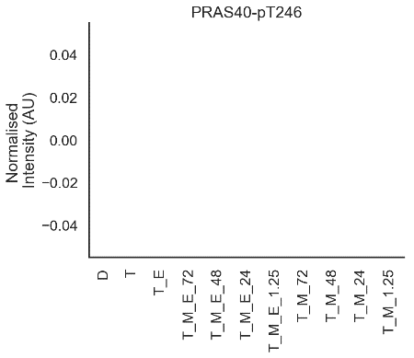
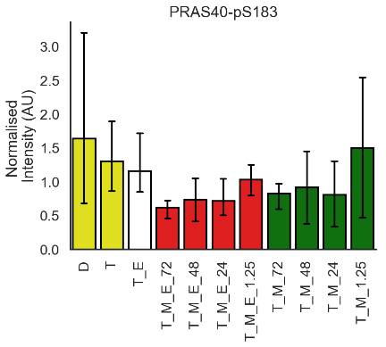
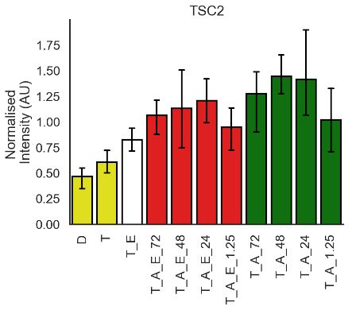
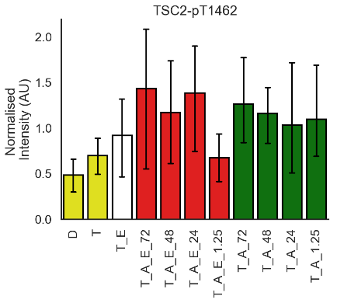
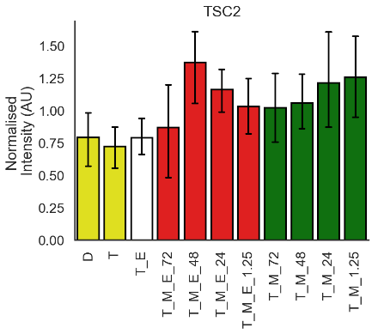
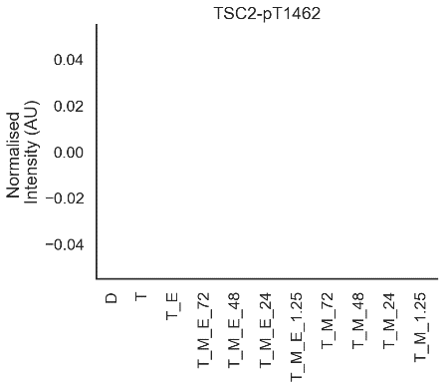
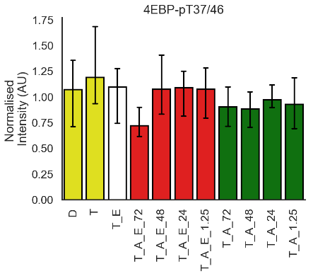
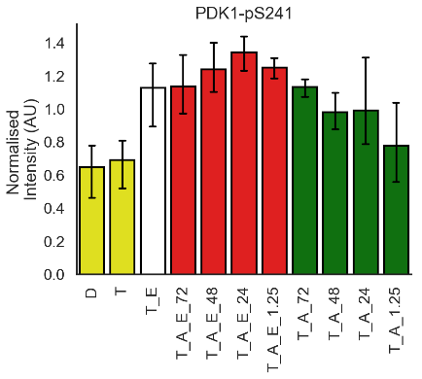
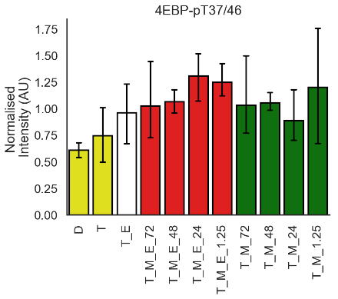
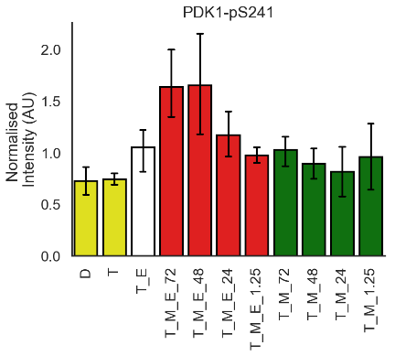
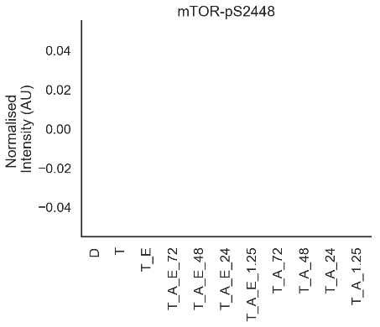
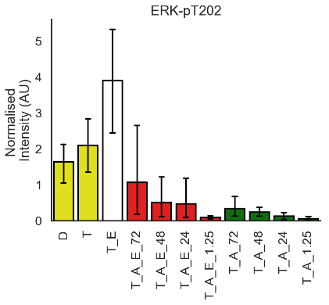
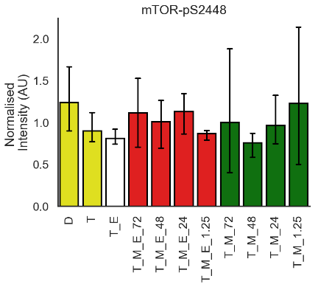
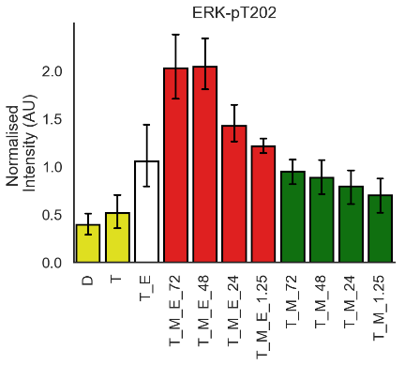
AZD
+ Everolimus
- Everolimus
MK

